Slide 1


Machine Learning Engineering Course
Graduation Task
October 2021
SOLVING REAL PROBLEMS IN SIERRA LEONE USING MACHINE LEARNING
PRESENTATION ON DISEASE TESTING SYSTEM BASED ON SYMPTOMS
Self-Introduction
Disease Testing System Based on Symptoms
Data Exploration
Proposed Method – Model
Results
Utility-Future Application
Company: DIVE INTO CODE Corp.
CEO & Facilitator: Hiroyoshi NORO
Presented by: James M Bockarie

Slide 2


Self-introduction
Career, Latest Project
Presented by: James M Bockarie

Slide 3
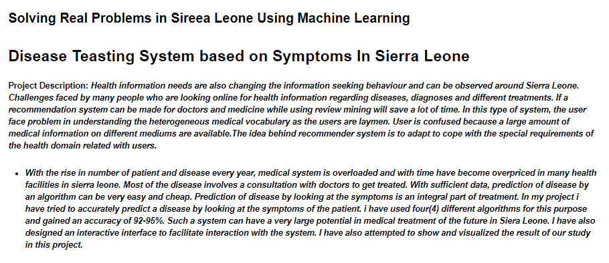
DISEASE TESTING SYSTEM BASED ON SYMPTOMS
Presented by: James M Bockarie

Slide 4
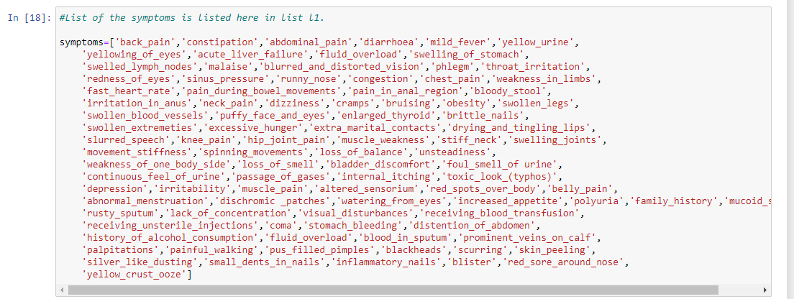
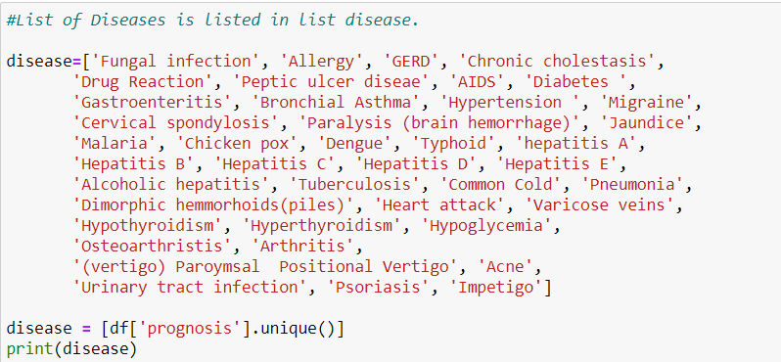
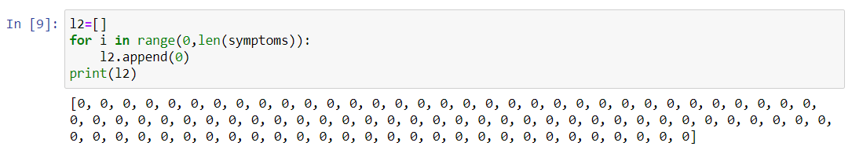
Data Exploration
Presented by: James M Bockarie

Slide 5
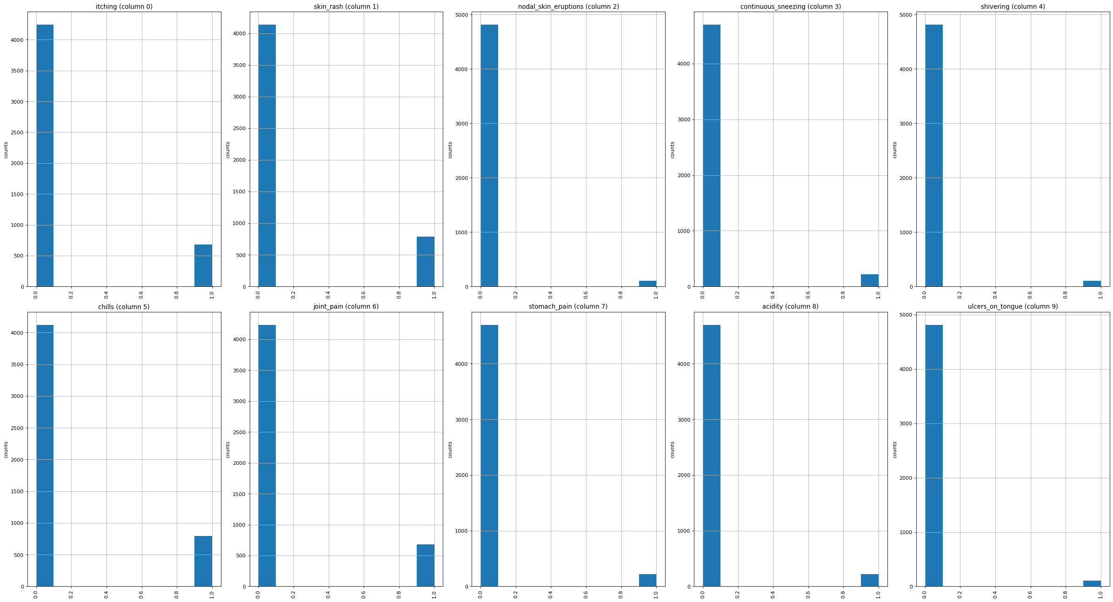
Data Exploration
I visualized the data using the distribution graph
Presented by: James M Bockarie

Slide 6
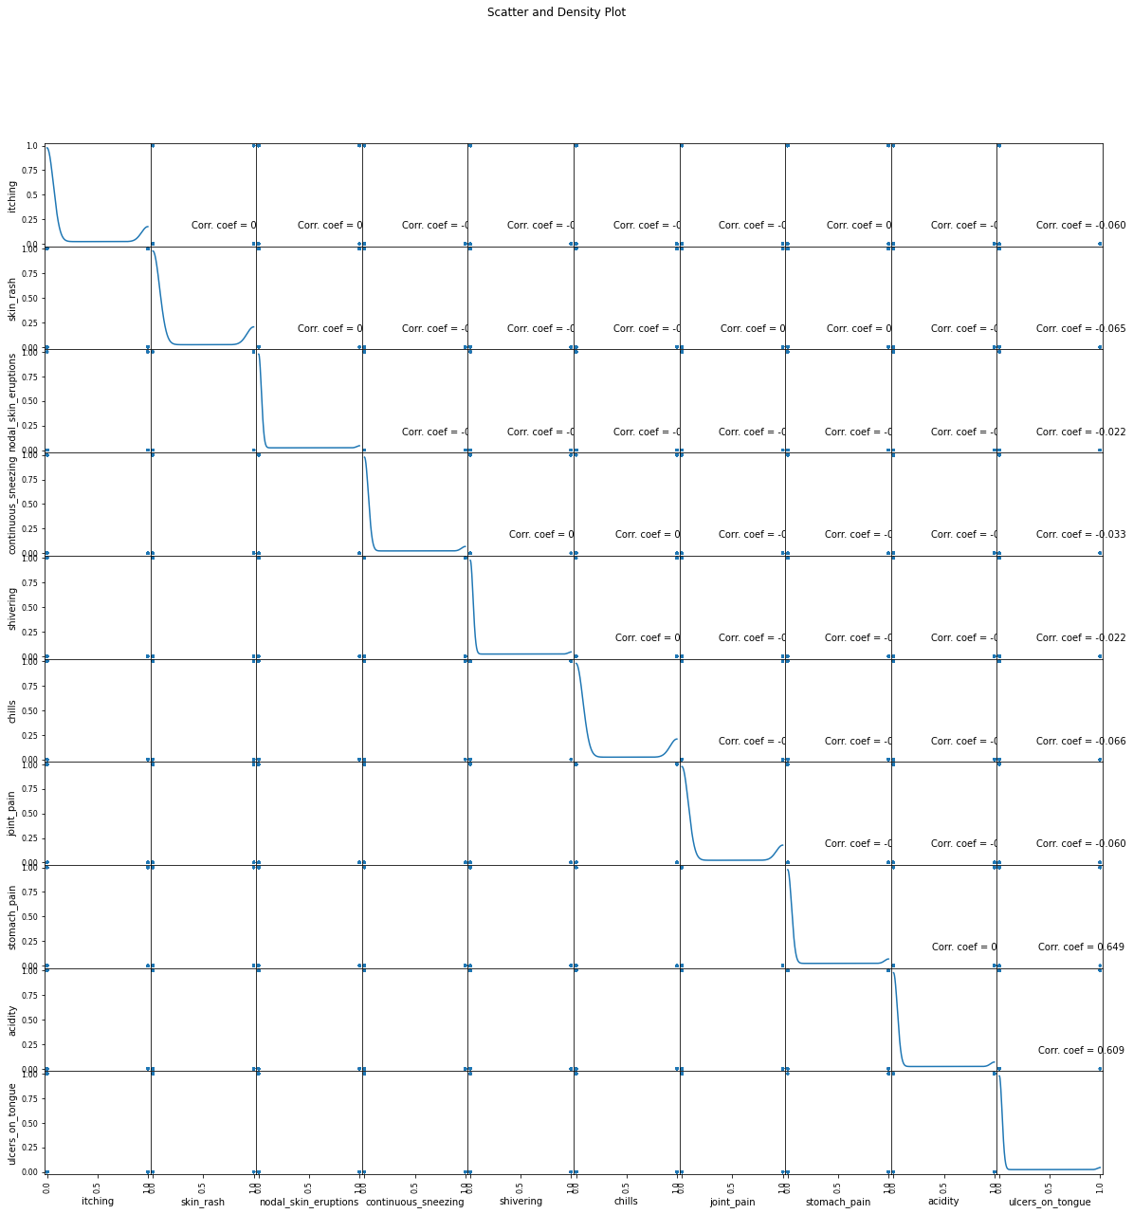
Data Exploration
I also visualized the data using the scatter and density plots
Presented by: James M Bockarie

Slide 7
Proposed Method – Model
Data Preparation
Train –Test Data Split
Build Classifiers
We Create two list that is
Most Common Symptoms of Different Disease in Sierra Leone list.
Most Common Diseases in Sierra Leone list.
We first create the symptoms lists
this list is made for various Symptoms which are generally showed up in people for various Diseases
Then we create the Disease list
This is the list made for different Diseases which are for the most part appeared in different individuals
We Later create L2 whish is the vacant list made. At that point, equivalent to a number of diseases in list L1, L2 (Symptom and Disease) is appended in a number of zeroes
Decision tree is the first prediction method we have used in our project. It gives us an accuracy of ~95%.
we have also used random forest classifier with 100 random samples and the result given is ~95% accuracy.
Then we used K Nearest Neighbour to classify our dataset and achieved ~92% accuracy.
This is lower than the first two methods
Finally In our project we have used naïve bayes algorithm to gain a ~95% accurate prediction.
There is a CSV document containing diseases and symptoms, named training.csv, which is utilized to prepare the model.
Read_csv() function is utilized to store the information in the data frame, named df.
Utilizing replace() function, prognosis column that are the different diseases, it is replaced by the numbers from 0 to n-1, where n is the number of different diseases present in .csv record. Head() function is utilized to print the initial five rows of the preparation data frame.
We visualize our dataset using distribution graph and Scatter and density plots
The dataset we used was aready preprocessed so it helps in easily classifying the data. This dataset is used to train our model.
All of this classifiers are used to train the model and predict the disease on testing dataset according to symptoms entered by the user
Presented by: James M Bockarie

Slide 8
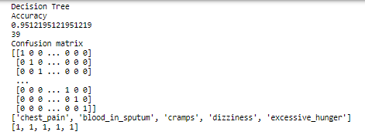
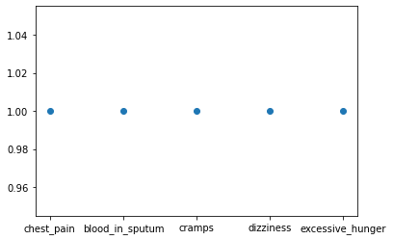
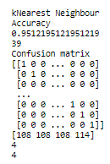
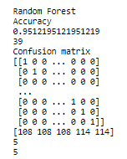
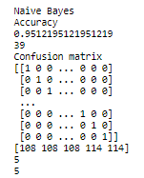
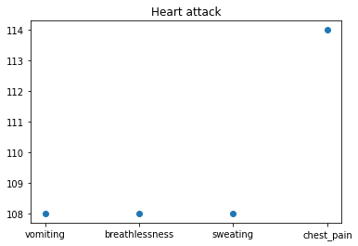
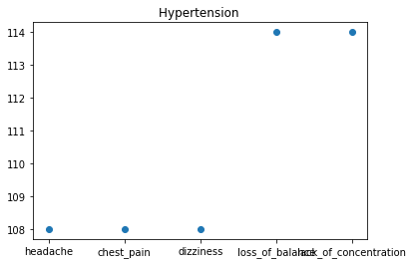
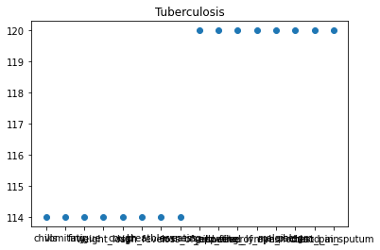
Results
Decision tree gives us an accuracy of ~95%.
random forest classifier with 100 random samples gives us ~95% accuracy.
K Nearest Neighbour gives us ~92% accuracy.
This is lower than the first two methods
Finally naïve bayes algorithm gives us ~95% accurate prediction.
After the application runs, the result based on the input of the users
Presented by: James M Bockarie

Slide 9
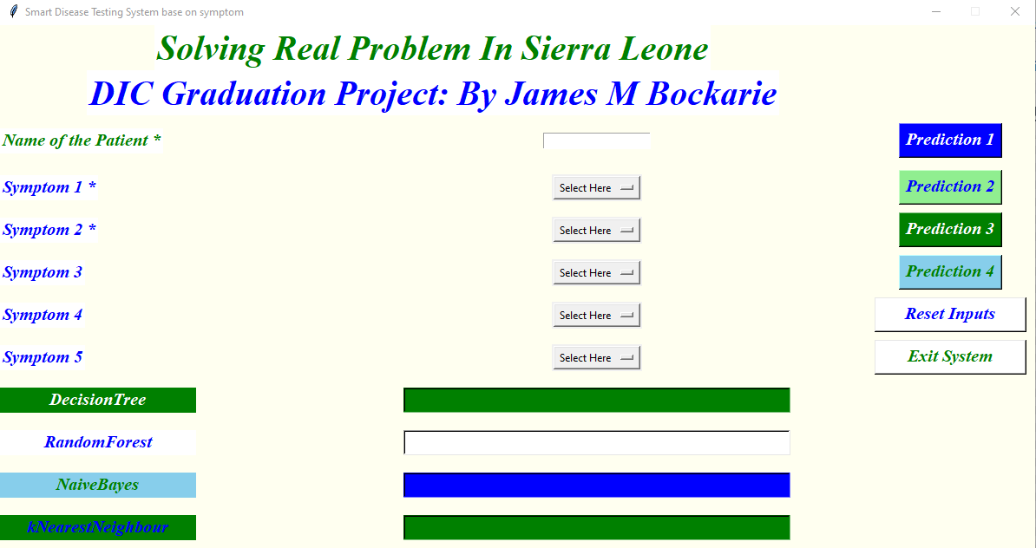
Utility-Future Application
Presented by: James M Bockarie

Slide 10
Thanks Very Much

